Slide 1

Data Engineering: World of Warcraft
Kevin Linder
Sarah Jung
Elizabeth Bauer

Slide 2
Project Overview
Kaggle Dataset : World of Warcraft demographic data
Use pgAdmin to load data into PostgreSQL database
Create an API access point using Flask
Extract data→
download raw csv
Transform data locally
Load data to DB for storage and access
Query data
API for for access to data
Python script to reorganize data into desired format
Use the Psycopg2 library to access PostgreSQL tables with Python

Slide 3
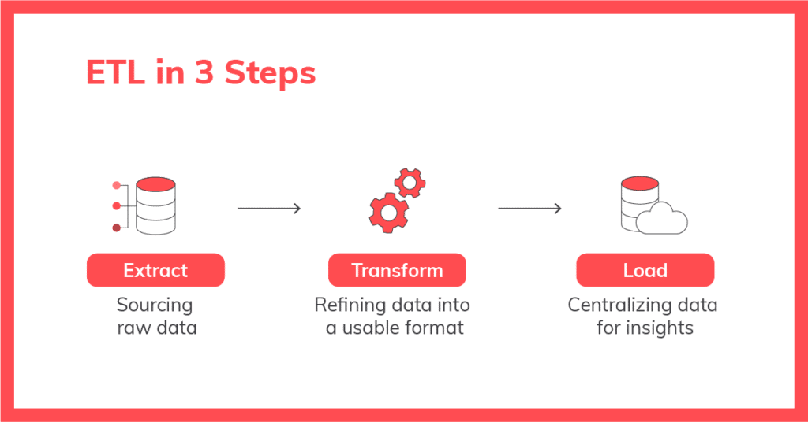
ETL - Extract and Transform
Extract:
Dataset downloaded from Kaggle
Transform:
Python script was written to:
Ingest raw csv
Split data into two distinct categories for later upload into two distinct tables
Add ‘id’ column and populate with values
Reorganize columns
Convert all string values to lowercase to normalize formatting
Output two new csv files, ‘player.csv’ and ‘character.csv’

Slide 4
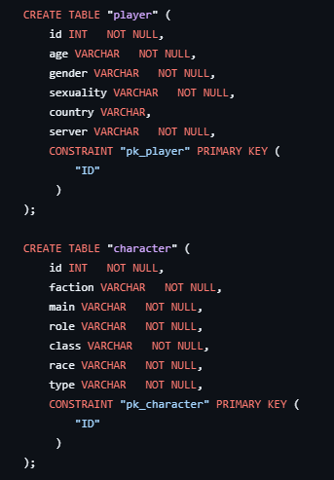
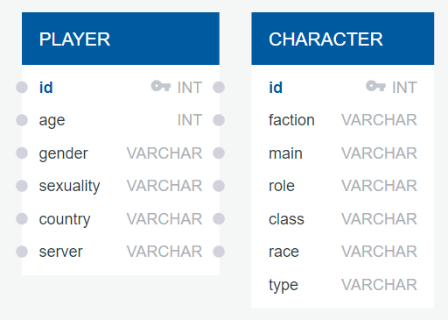
ETL - Load
Load:
Database diagram created to visualize database structure
Schema created
“Player” and “Character” tables created
CSV files loaded into PostgreSQL tables using pgAdmin

Slide 5

Query the data using PGAdmin
Player Analysis
Among World of Warcraft players, which age group World of Warcraft is most common among:
Gender, Sexuality, Country breakdown within each age bracket
Reasons to use PostgreSQL for hosting data:
relational format to sectionalize data into distinct demographic categories.
Scalability- we have started with a very small dataset, but there is an enormous World of Warcraft player base, so we need to be able to scale if we were to collect more player data.
Findings:
Most common Age range: 18 - 30 (66 total players)
Most common gender: Female (37 of 66 players)
Most common sexuality: Bi/Pan Females (21 of 37 players)

Slide 6
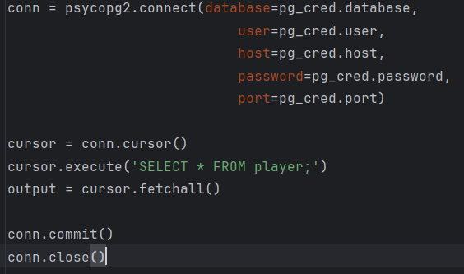
Psycopg2 Library- Database Access
Straightforward library that enables easy access to postgreSQL databases from python programs.
Easy setup and integration
Query style follows standard SQL query string format
Output format is ideal for conversion into JSON or DataFrames

Slide 7
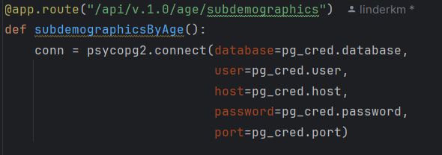
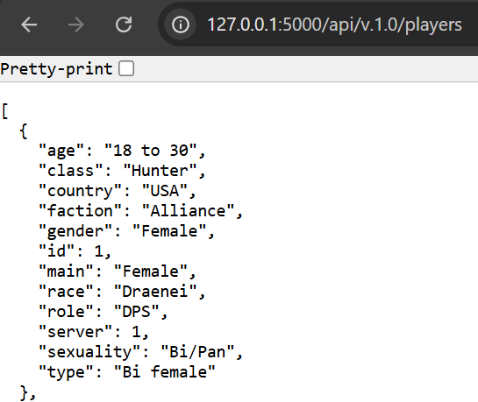
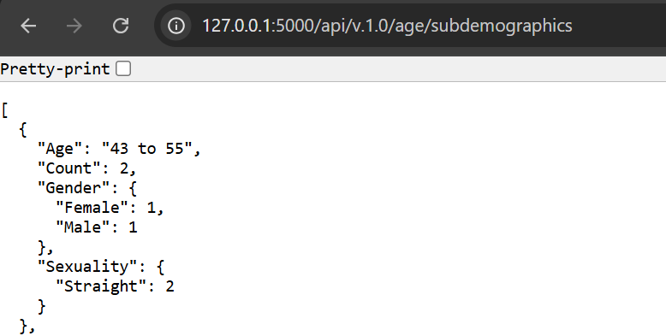
Flask API
Our primary method for making the data available for a hypothetical user.
Visualize the data in JSON format.

Slide 8
Thanks for tuning in!

